Slide 1
Exercise 9 - Discussion
Nucleophilic Addition to Carbonyl Groups, Hydrate/(Hemi-)Acetal-Formation, Sugar Chemistry

Slide 2
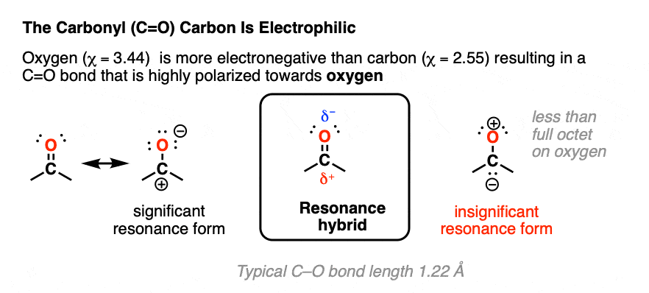
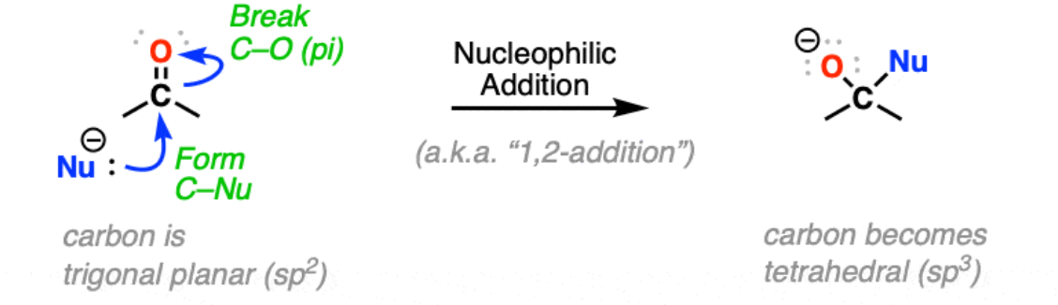
Nucleophilic Addition to Carbonyl Groups
Mechanism
Reactivity Trends
Electronic effects
Electron withdrawing groups increase reactivity
Electron pushing groups reduce reactivity
Steric effects
Steric bulk reduces reactivity
Adddition can be reversible for weekly basic nucleophiles and irreversible for highly basic nucleophiles.
Figure Source: https://www.masterorganicchemistry.com/2022/09/09/nucleophilic-addition/

Slide 3
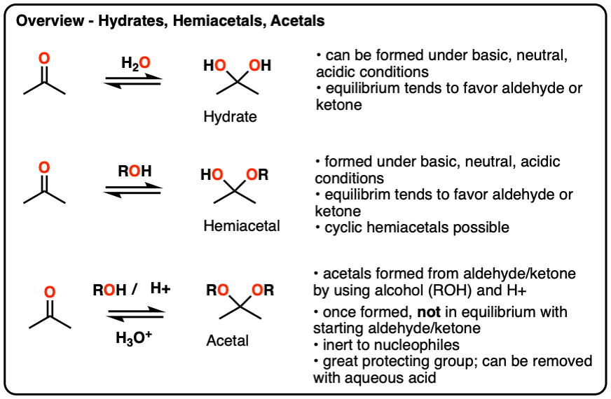
Hydrates / (Hemi-)Acetalformation: Nomenclature
Hydrates, hemiacetals and acetals are the products of addition reactions of oxygen-based nucleophiles (water and alcohols) to aldehydes and ketones
Nomenclature
A hydrate contains a carbon with two single bonds to OH.
A hemiacetal contains a carbon with a single bond to OH and a single bond to OR (where R is a carbon group)
An acetal (sometimes called a ketal if originating from a ketone) contains a carbon with two single bonds to OR groups.

Slide 4
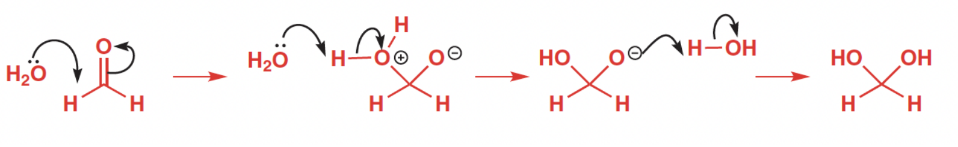
Hydrate / (Hemi-)Acetalformation: Reaction Mechanisms
Hydrateformation: Addition of water to aldehydes
Hemiacetalformation: Addition of an alcohol (ROH) under basic or acidic conditions
Acetalformation: Addition of two alcohol groups (2 ROH) under acidic conditons

Slide 5
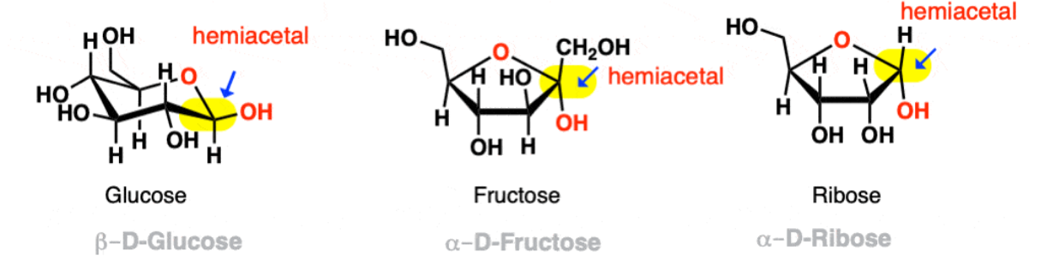
Sugar Chemistry
Sugars are examples for Hemiacetals in Nature
The ring forms are created through Intramolecular Hemiacetal Formation

Slide 6
Exercises
Nucleophilic Additon and Reactivity: 9.1, 9.4
Hydrate and (Hemi-)Acetalformation: 9.8, 9.3, 9.2
Sugar Chemistry & Biological Application: 9.6, 9.7, 9.5

Slide 7
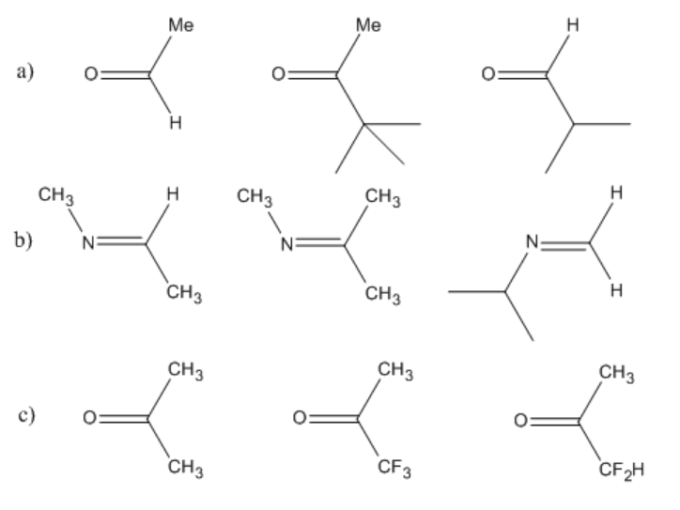
Nucleophilic Additon and Reactivity: 9.1
Most reactive
Least reactive
Least reactive
Most reactive

Slide 8
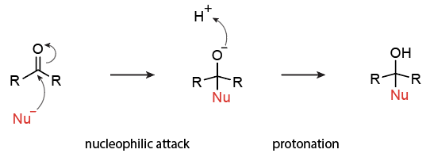
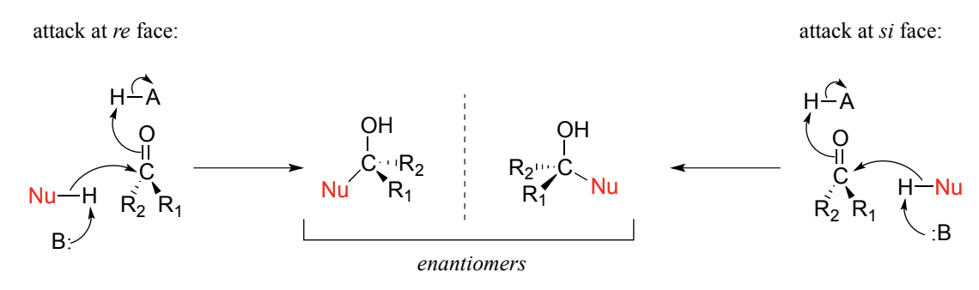
Nucleophilic Additon and Reactivity: 9.4
Reaction Mechanism
Stereochemical Outcome

Slide 9
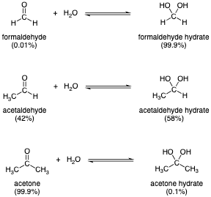
Hydrate Formation: 9.8

Slide 10
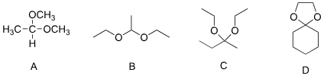
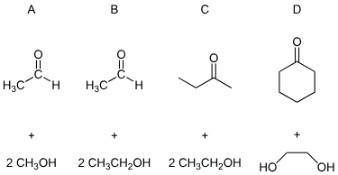
Acetal/Ketal Formation: 9.3
Products
Educts

Slide 11
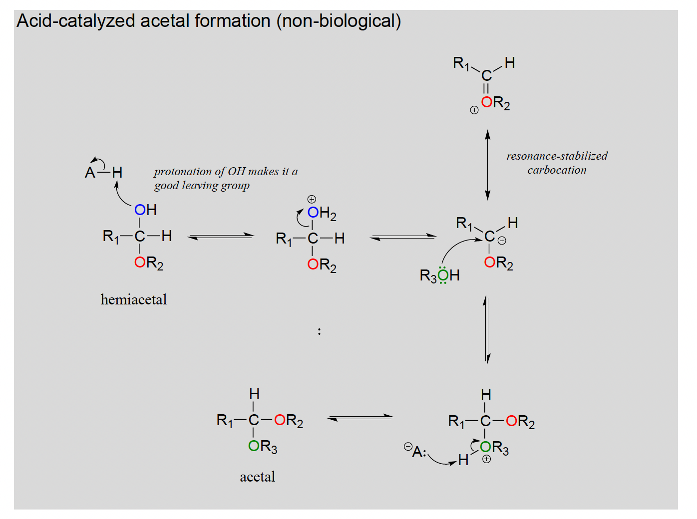
Acetals/Ketal Formation Mechanism: 9.2
SN1 type mechanism

Slide 12
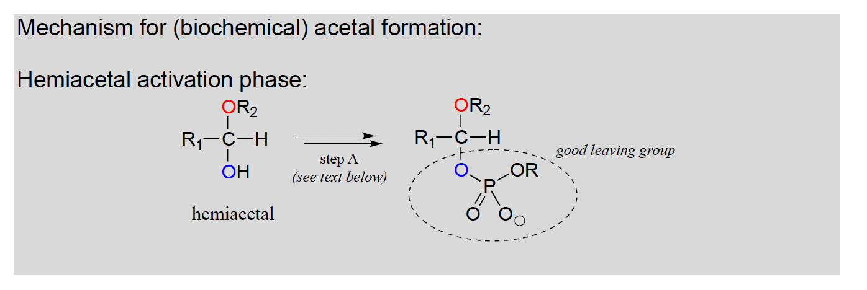
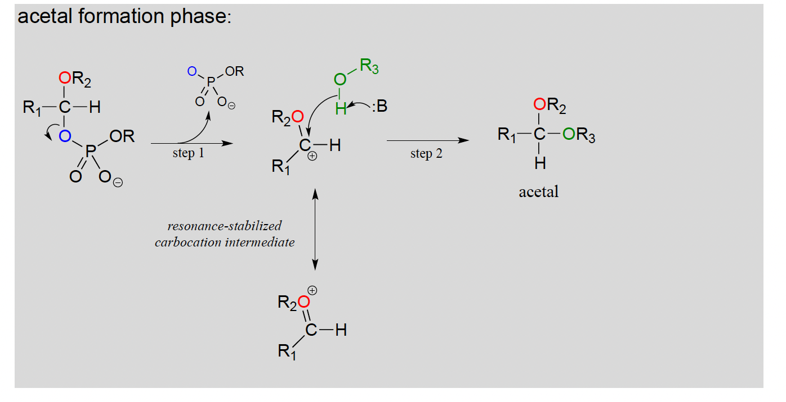
Acetals/Ketal Formation Mechanism: 9.2

Slide 13
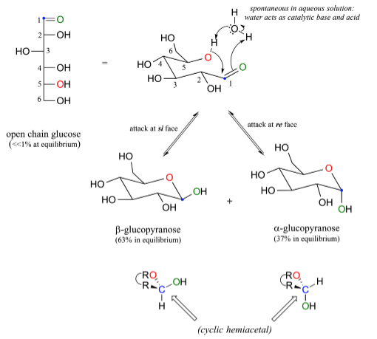
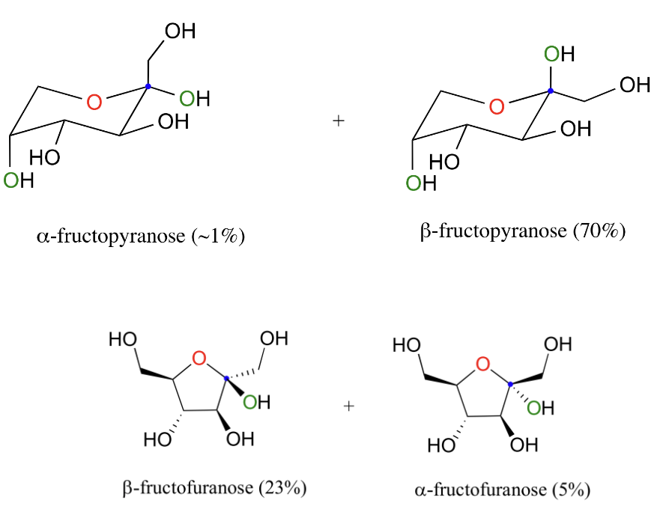
Sugar ring closure: 9.6
a
b

Slide 14
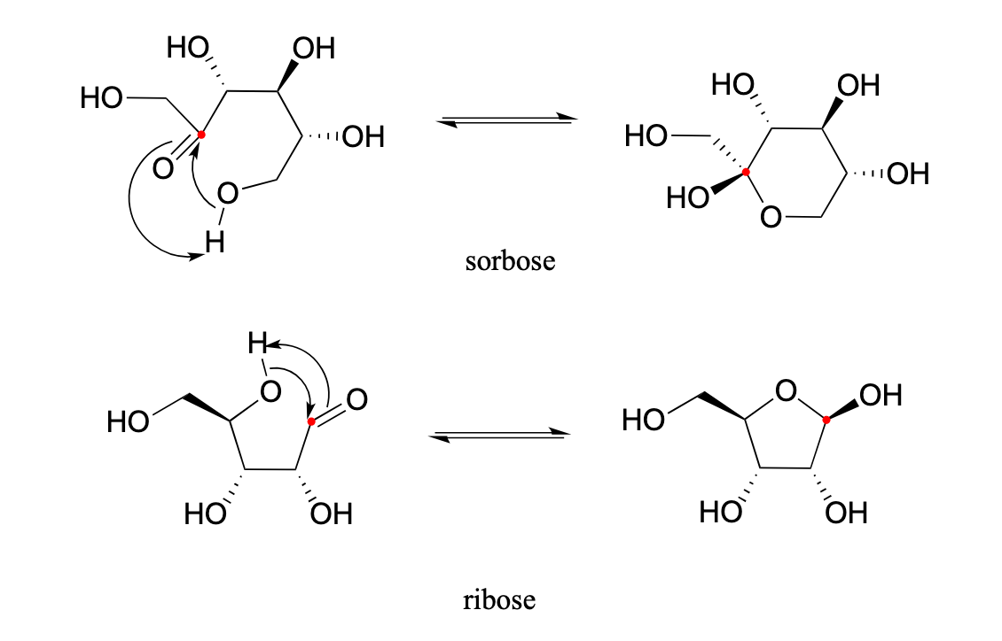
Sugar ring closure: 9.7

Slide 15
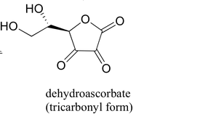
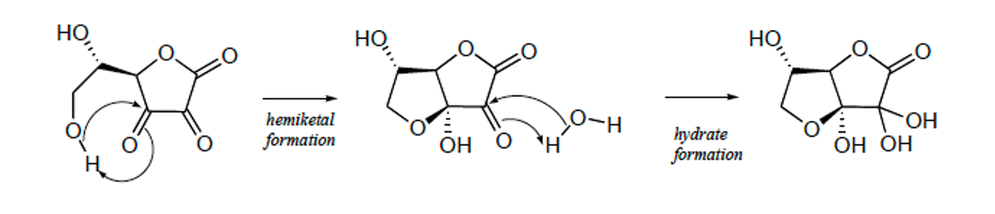
Vitamin C: 9.5
1
ketone groups is in its hydrated form, and the other is an intramolecular hemiketal
3
2

